Slide 1
LAB#A Host code Optimization
speaker：張耀明
advisor：賴瑾

Slide 2
Topic
Introduction
System introduction
Host program
LAB1-pipeline
In order queue
Out of order queue
LAB2-Synchronization
Clfinish
Event control
LAB3-Buffersize
Buffersize
buffersweep
conclusion

Slide 3
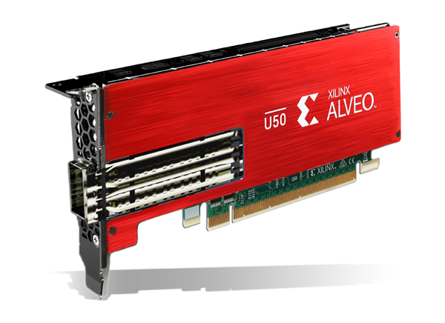
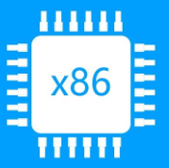
Introduction
Teacher:
1 The Latency of PCIe is long。
2. The kernel execute time should longer than the Latency for acceleration
PCIe
lantency

Slide 4
Introduction
Platform: U50 platform (XRT)
Host code : Three different Host codes that implement 3 different host code optimization.
Software Pipeline/Event Queue
Kernel and Host Code Synchronization
Buffer size
Kernel：Implement a simple addition with for loop.(Kernel function is not important in this lab)

Slide 5
Introduction
1. Host side send input data x
2. Fpga do the computation x=x+processdelay
3. Host receive the output
x
x+processdelay

Slide 6
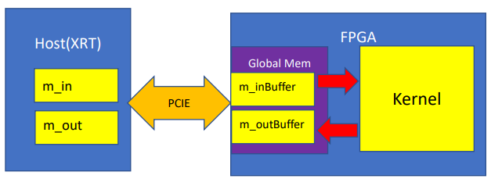
System diagram
m_in,m_out : host memory that handle the input data to FPGA and output data from FPGA
m_inBuffer,m_outBuffer ： Buffer associated with m_in, m_out , which are allocated in FPGA’s HBM Global memory

Slide 7
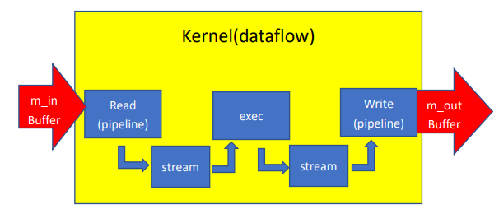
Kernel
The whole Kernel contains three blocks: Read, exec, Write.
Read and Write use pipeline, and the Kernel use dataflow
These blocks communicate with stream
Read: Read data into kernel from buffer.
Write: write data back to buffer.
exec: Addition with for loop
Axi_master
Axi_master
Axi_stream
Axi_stream

Slide 8
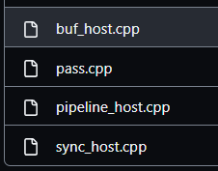
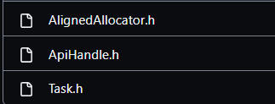
Host program
1. OpenCL : Host memory allocate (AlignedAllpcator.h),handle Opencl API(ApiHandle.h) and execution flow(Task.h),
2. C++ : Use the Api with different parameters and arguments to implement different optimization.
Host program
OpenCL API
Execution flow
C++ host code

Slide 9
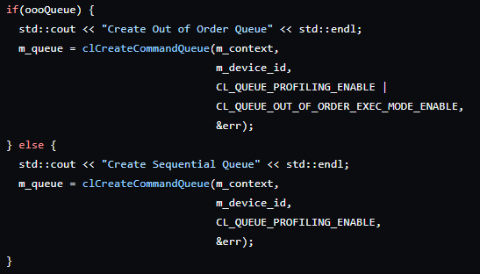
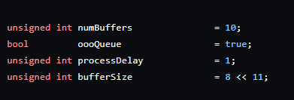
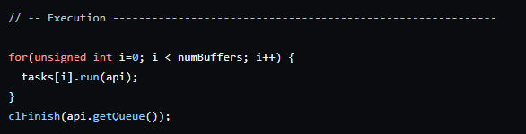
Host program parameter
numBuffer: Determine how many kernel(tasks) invocations are performed
oooQueue :Determine whether enable out of oder queue in commamd queue or not
processDelay:Provides the similarly-named kernel parameter, and it is also used during validation.
bufferSize: Determines how many 512-bit values are transferred when this task is executed.

Slide 10
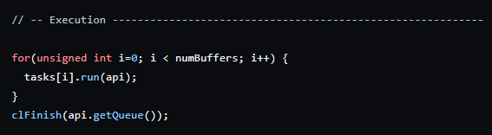

Host program execution flow
The execution flow of a single “task”
The task is called numBuffer times during every lab.
(Blue : transfer data between host and fpga through PCIE)
CreateBuffer
Set kernel Argument
migrate input buffer
Enqueue
Task
Receive output buffer
task
Done Event

Slide 11
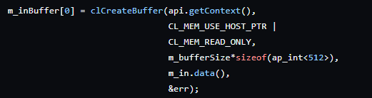
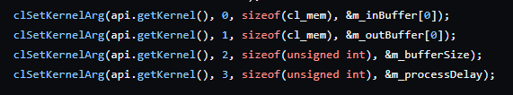
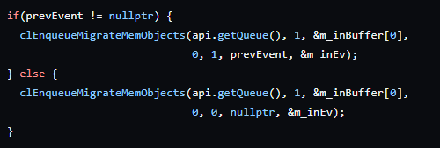

CreateBuffer
Set kernel Argument
migrate input buffer
Enqueue
Task
Receive output buffer

Slide 12
Recall : command queue
Host control Kernel execution through Command queue
Host push commands into command queue, FPGA execute the commands
Two kinds of command queue: in-order queue, out-of-order queue
Command queue
CreateBuffer

Slide 13
Out of order execution
In-order-queue: time consuming, but stable
Out-of-order queue: out-of-order execution (more efficient)
Task1
Task2
Task3
CreateBuffer
Set
Ker
arg
migrate input buffer
Enqueue
Task
Receive output buffer
task1
CreateBuffer
Receive output buffer
task2
Set
Ker
arg
migrate input buffer
Enqueue
Task

Slide 14
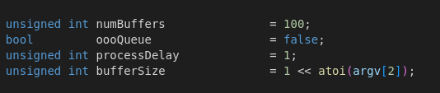
LAB1 In-order Queue
This lab implements the host code with in order queue
Execution code:

Slide 15
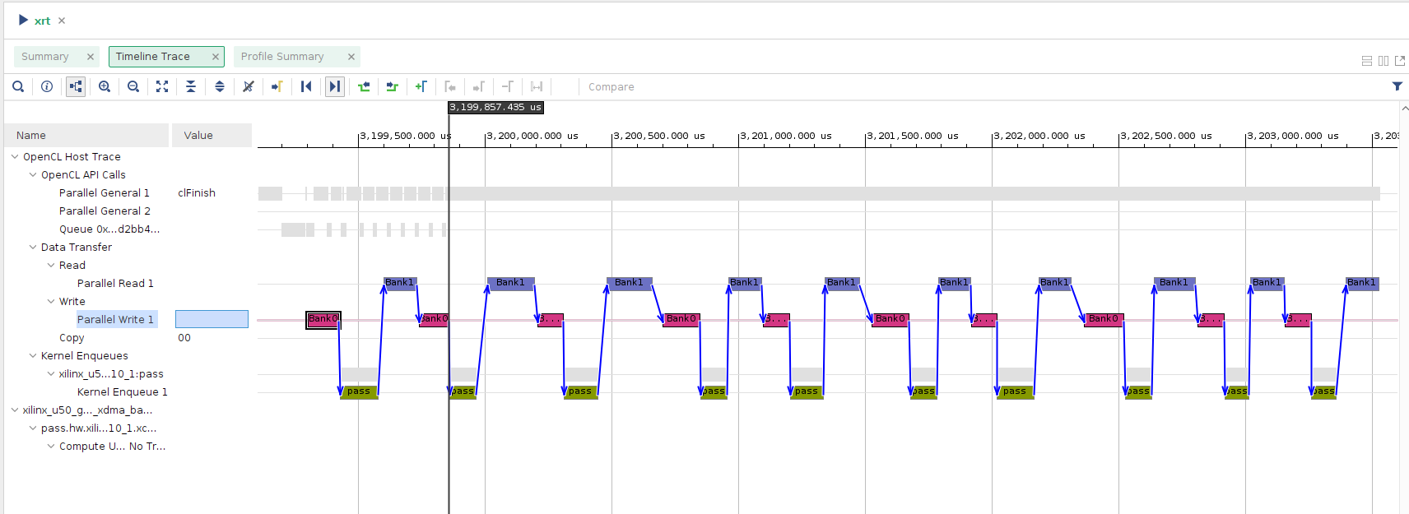
LAB1 In-order Queue
Timeline

Slide 16
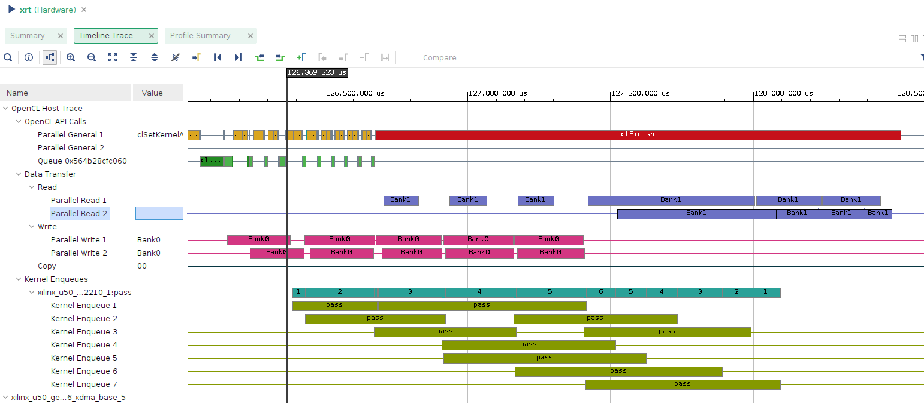
LAB1 out of order Queue

Slide 17
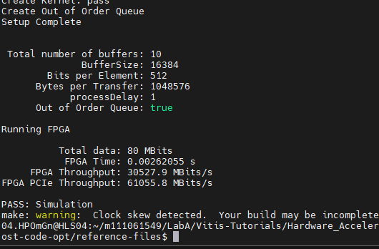
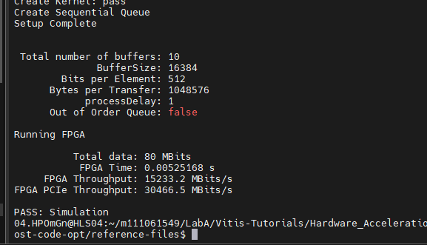
LAB1 conclusion
Execution time:0.0052->0.0026

Slide 18
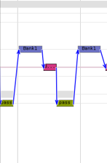
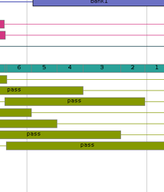
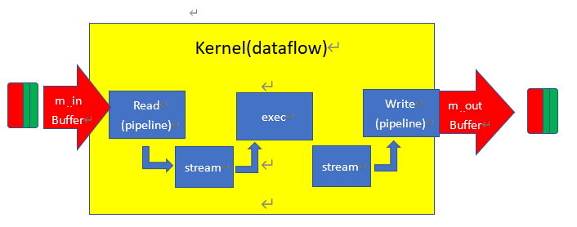
LAB1 conclusion
Execution time of a single task(pass) implementing by out of order queue is longer than that using the in-order queue

Slide 19
LAB2 Synchronizaion
Issue may cause in LAB1:
May run out of memory if the number of tasks(numBuffer) is large
Problems occur if the current task needs the previous tasks’ output

Slide 20
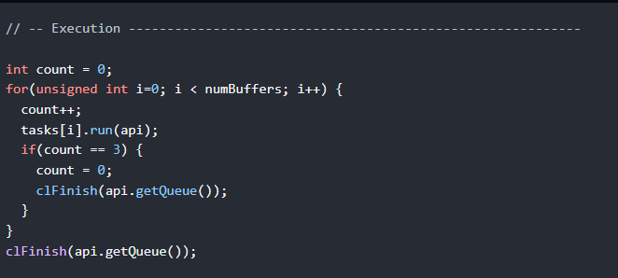
LAB2 synchronization using Clfinish
Add synchronization point by calling clfinish() after every three tasks is called
Task1
Task2
Task3
Finish
Task4
Task5
Task6
Finish

Slide 21
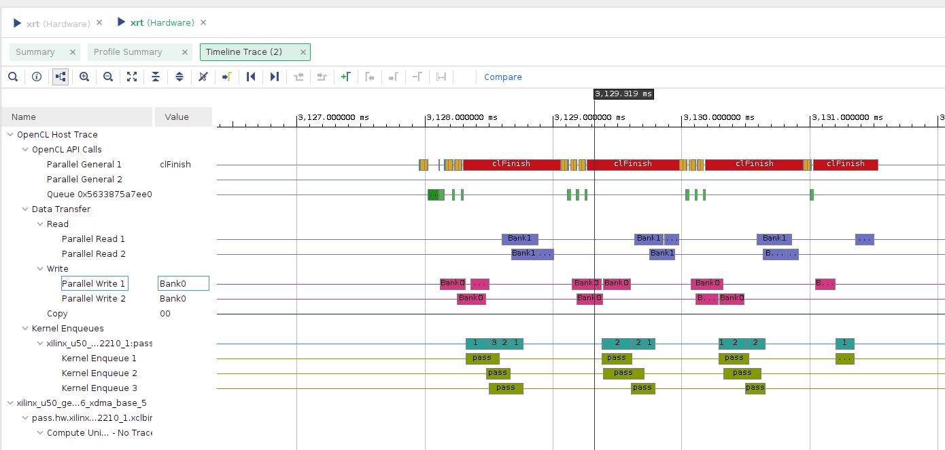
LAB2 synchronization using Clfinish

Slide 22
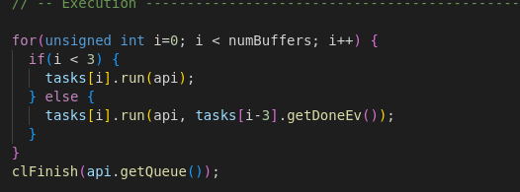
LAB2 synchronization using Event control
Host code

Slide 23
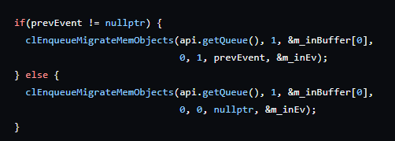
LAB2 synchronization using Event control
i�-th
Starting from the fourth task, the “migrate input buffer” of all tasks must wait for a “Done event” occurs
Because putting a command into queue is far more faster than execute a kernel function, it turns out that the the migration step of i-th task needs to wait for the (i-3)-th task to be done
CreateBuffer
Set kernel Argument
migrate input buffer
Enqueue
Task
Receive output buffer
i-th task
Wait for
Done Event
Done Event
Produce by the i-3 th task
Done Event
For the i+3 th task

Slide 24
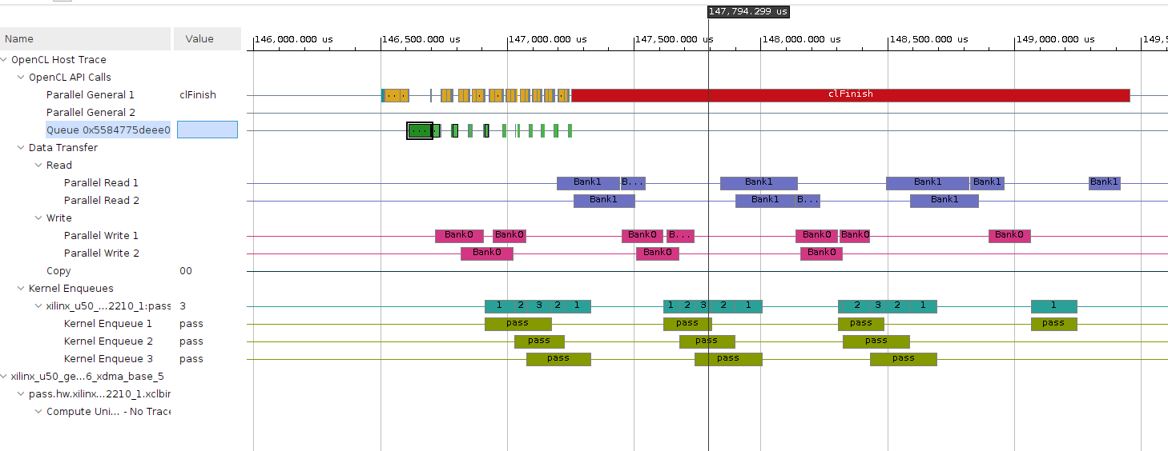
LAB2 synchronization using Event control

Slide 25
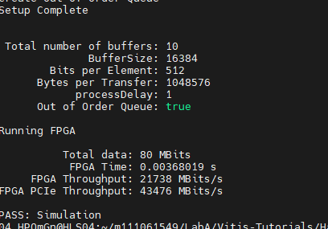
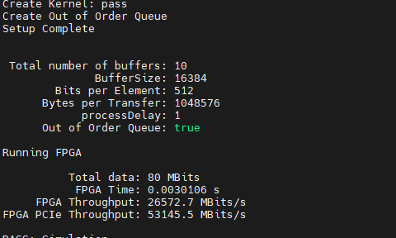
LAB2 conclusion
0.0036(clfinish)<0.0030 (event control)< 0.0026(lab1)

Slide 26
LAB3 buffer size
True

Slide 27
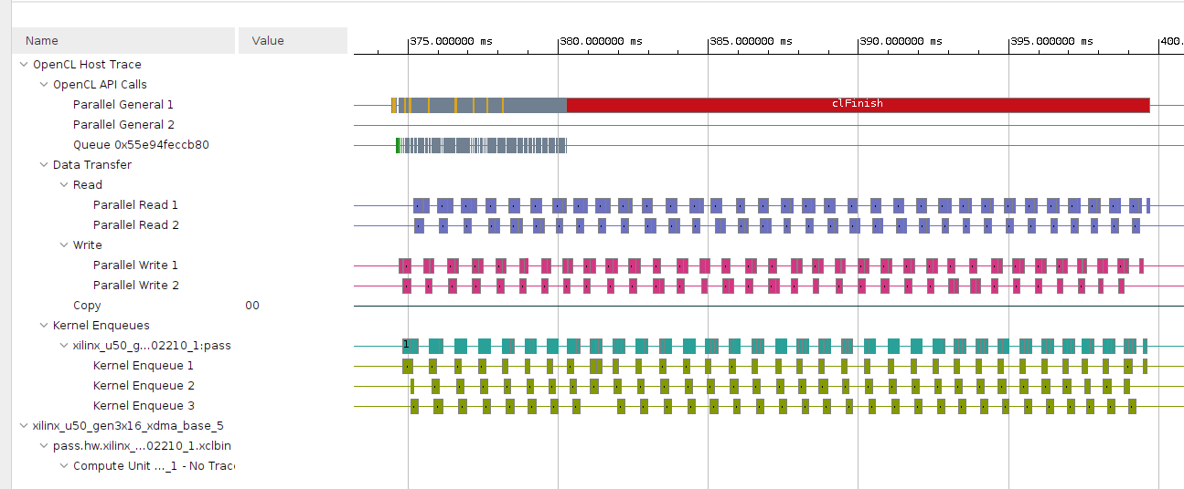
LAB3 buffer size

Slide 28
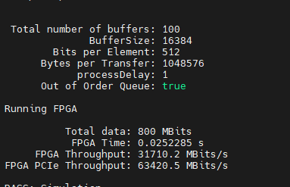
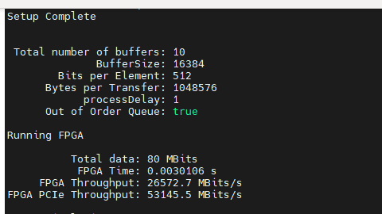
LAB3 vs LAB2 event control
The larger the number of tasks is, the higher the throughput of FPGA and PCIe are.
Is it always the case?

Slide 29
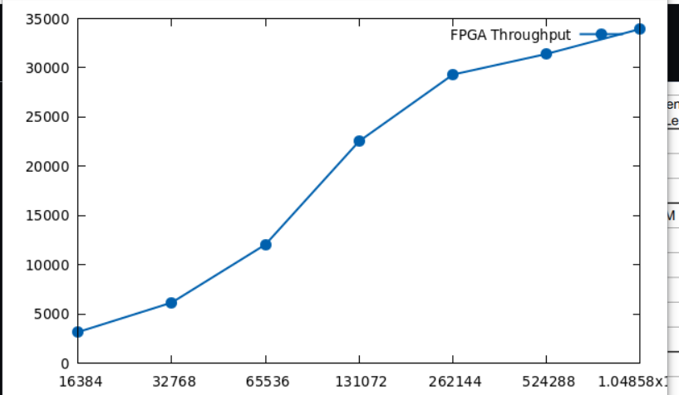
LAB3 buffer sweep
Execute Lab2 event control with numbuffers increasing
Approx:
30000Mbits/s
Max throught:
About 34000Mbits/s

Slide 30
Conclusion
When designing a kernel function for an application, it is also important to increase the FPGA throughput, hardware/IO port utilization by optimizing the host program.

